Slide 1
BLOCKCHAIN BASED SECURE DATA TRANSFER IN CLOUD STORAGE
BATCH 18
TEAM MEMBERS:
Abitha U [211419104004]
Kaviasree S [211419104129]
Phooja shree R[211419104189]
GUIDE:
Dr.K.Sangeetha, M.E, Ph.D.

Slide 2
ABSTRACT:
The growth in technological advancements has led to the abrupt rise in the improvement of digital belongings and transactions. The documents or files are more prone to information breaches and theft from the intruders who are successful in obtaining the data. This led to the advancement of adopting concepts from the blockchain. Blockchain is best known as data sharing technology with respect to its application in Organization data transactions. A blockchain is a growing list of distributed records that are connected to each other through the usage of cryptography. It offers data security in an encrypted format.

Slide 3
EXISTING SYSTEM:
The technique used is LAST-HDFS which integrates Location-Aware Storage Technique (LAST) into the open source Hadoop Distributed File System (HDFS)
The file transfer analysis is realized with a component called Host-based Socket Monitoring.
The socket monitor is in charge of monitoring all of the communication that occurs between the multiple nodes within the cloud infrastructure.
The socket monitor only detects packets transferred between nodes but not the content of the packets.
In the existing system there is a chance to make the login process by unknown users with valid user’s mail ids.
It may lead to malicious activities in various ways, such data will be known by unknown users, data or file maybe lost and so on.

Slide 4
PROPOSED SYSTEM:
The Proposed System considers an organization into account where the input file or data which a project manager or any other employee in a particular organization needs to share with others in the organization is converted into fixed-sized blocks of data, which is similar to the concept used in blockchain.
Here the manager browses and adds different files for each section of employees with different access rights, so the employee with the respective access right (valid organization IP address) could request for the file.
The approach not only ensures confidentiality and integrity of files, but also provides a scalable key management mechanism for file sharing among multiple users.
After checking the requests by authority person, if the user is valid, then the user can get the response through mail and if the user is not valid then their request will be rejected.

Slide 5
LITERATURE SURVEY:
YEAR | AUTHOR NAME | PAPER DETAILS | METHODOLOGY | MERITS | DEMERITS
2021 | Adam Bowers, Cong Liao, Douglas Steiert , Dan Lin , Anna Squicciarini, and Ali Hurson | TITLE: Detecting Suspicious File Migration or Replication in the Cloud VOLUME: 18 ISSUE:1 JOURNAL: IEEE | The technique used is LAST-HDFS which integrates Location-Aware Storage Technique (LAST) into the open source Hadoop Distributed File System (HDFS). | It is capable of detecting potential illegal transfers which moves sensitive data outside the boundaries specified by the file owner. | It may lead to malicious activities in various ways, such data will be known by unknown users, data or file maybe lost.

Slide 6
YEAR | AUTHOR NAME | PAPER DETAILS | METHODOLOGY | MERITS | DEMERITS
2022 | Anusree K, Jagan Sathiaseelan Vadekkat, Abhinu R Dev, Abhinav | TITLE: Decentralized File Transfer System Blockchain-based File Transfer VOLUME: 11 ISSUE:5 JOURNAL: IJERT | The purpose is to solve the need for blockchain applications to exchange larger files with sensitive information within an organization using Inter Planetary File System (IPFS). | The goal of this system is to use the blockchain concept to promote file sharing services with greater security and lower risk. | Anyone connected to the database can check other users rights for the file they are sharing.

Slide 7
YEAR | AUTHOR NAME | PAPER DETAILS | METHODOLOGY | MERITS | DEMERITS
2021 | Devesh Solanki , Dev Mehta , Kaushal Modani, Sashank R M Dr Rashmi S | TITLE: An Android File Sharing System Using BlockChain & IPFS VOLUME: 9 ISSUE: 5 JOURNAL: IJCRT | The Android App is designed for secure storage and protection using BlockChain and IPFS. | As blockchain is immutable, it is not possible to alter the package information in any way. | Different types of attacks on the sensitive data is possible.

Slide 8
YEAR | AUTHOR NAME | PAPER DETAILS | METHODOLOGY | MERITS | DEMERITS
2020 | Jin Sun, Xiaomin Yao , Shangping Wang , and Ying Wu | TITLE: Blockchain-Based Secure Storage and Access Scheme For Electronic Medical Records in IPFS VOLUME:8 JOURNAL: IEEE | In this work a new encryption scheme for secure storage and efficient sharing of electronic medical records based on the attribute-based encryption system, blockchain technology, and the InterPlanetary File System (IPFS) storage platform. | The scheme provides good access control for the electronic medical records using attribute-based encryption technology so that people who are not related to the patient cannot see the private data of the patient without authorized. | Access privilege is one of the shortcoming.

Slide 9
YEAR | AUTHOR NAME | PAPER DETAILS | METHODOLOGY | MERITS | DEMERITS
2020 | Anjaly Renny , Anjana Santhosh , Neeraja S, Teena Noyal | TITLE: File Storing and Sharing using Blockchain VOLUME: 9 ISSUE: 6 JOURNAL: IJIRSET | The File Storing and Sharing is done using Blockchain and AES algorithm. | It is much secure, efficient and effective. | Suspicious activities may occur.

Slide 10
YEAR | AUTHOR NAME | PAPER DETAILS | METHODOLOGY | MERITS | DEMERITS
2018 | Shujie Cui, Muhammad Rizwan Asghar, Giovanni Russello | TITLE: Towards Blockchain - based Scalable and Trustworthy File Sharing CONFERENCE: IEEE | In this work, a blockchain and proxy re-encryption based design for encrypted file sharing that brings a distributed access control and data management is used. | It provides a scalable key management mechanism for multiple access. | Any user with valid login details can access the data.

Slide 11
YEAR | AUTHOR NAME | PAPER DETAILS | METHODOLOGY | MERITS | DEMERITS
2018 | Xiaochen Zheng, Raghava Rao Mukkamala, Ravi Vatrapu, Joaqun Ordieres-Mere | TITLE: Blockchain-based Personal Health Data Sharing System Using Cloud Storage CONFERENCE: IEEE | In this work a conceptual design for sharing personal continuous-dynamic health data using blockchain technology. It is used to enable users to own, control and share their personal health data securely, in a General Data Protection Regulation (GDPR). | It uses different solutions to share the large size continuous- dynamic data using hash pointers to the storage location. | Data leakage is possible.

Slide 12
YEAR | AUTHOR NAME | PAPER DETAILS | METHODOLOGY | MERITS | DEMERITS
2018 | Mathis Steichen, Beltran Fiz, Robert Norvill, Wazen Shbair and Radu | TITLE: Blockchain-Based, Decentralized Access Control for IPFS CONFERENCE: IEEE | This paper presents a modified version of the InterPlanetary Filesystem (IPFS) that leverages Ethereum smart contracts to provide access controlled file sharing. The smart contract is used to maintain the access control list, while the modified IPFS software enforces it. | Users can efficiently share large files and still benefit from the blockchain. | The file requested by different user is accessed by the specific user based on the priority of the request.

Slide 13
YEAR | AUTHOR NAME | PAPER DETAILS | METHODOLOGY | MERITS | DEMERITS
2017 | Hoang Giang Do, Wee Keong Ng | TITLE: Blockchain-based System for Secure Data Storage with Private Keyword Search CONFERENCE: IEEE | This system makes use of blockchain technology – RSA Algorithm to enforce the data integrity via proof-of-retrievability scheme. | This system allows the client to upload their data in encrypted form, distributes the data content to cloud nodes and ensures data availability using cryptographic techniques. | The encrypted dataset which is having a complex private keyword is difficult to search.

Slide 14
YEAR | AUTHOR NAME | PAPER DETAILS | METHODOLOGY | MERITS | DEMERITS
2010 | Marlene Goncalves, Graciela Perera and Stephen Rodabaugh | TITLE: Detecting illegal file sharing in Peer-to-Peer networks using fuzzy queries CONFERENCE: IEEE | This paper has presented an architecture that enriches the process of detecting illegal sharing files in P2P networks using fuzzy queries. Fuzzy queries are useful to express user’s criteria that allow identifying and discriminating suspicious hosts, answers are discriminated by the membership function. | To detect possible sources of illegal file sharing. | If the fuzzy queries are complex then it is difficult to rewrite using reformulator.

Slide 15
PROBLEM STATEMENT:
In this project, we examine how the data source is managed throughout the organization. The main objective of this project is to ensure the safety measures against the security breach. Technology developments have generated enormous amounts of data, including sensitive and personal information. These days, there are many security issues, including difficulties with access control, scalability, virtualization, privacy, and massive data processing. One of the most popular technology for data security is blockchain. The sensitive files are first converted to fixed-sized blocks of data that are then encrypted using modified AES and SHA-256, taking into account the instance of a company or organization. IP addresses are utilized in such a way that they are checked for each action.

Slide 16
MODULES:
Login
Add File
View
Request
Response
Download

Slide 17
MODULE DESCRIPTION:
LOGIN:
This module gives the way to enter into main page after login with valid input such as or email id and password.
ADD FILE:
This module helps the manager and staff to add the file or document to the database, which can be viewed by the user.
VIEW:
This module helps the user to view the file. But the staff cannot open the file until they get response for the request to open it. The file uploaded by the staff can be viewed and opened by the manager of the organization.

Slide 18
REQUEST:
This module helps the staff, request the file to the head and the head accept the request if the IP address is valid or else the request gets rejected if the IP address is invalid. This Request module is mainly based on the IP address of the device.
RESPONSE:
This module helps the user requested file to be accepted by the head. And the unknown user or third party also request the file. But the unknown user request IP address will be verified by the head. If the IP address is valid then they will get accepted, if it is invalid then they will get rejected.
DOWNLOAD:
This module help the user to download the file after head approve the request. The file can be downloaded using Secret key. In this project we are using two secret key one is the secret key generated when the file is added and the other one is QR Code key.

Slide 19
SHA-256:
SHA 256 is a part of the SHA 2 family of algorithms, where SHA stands for Secure Hash Algorithm.
The significance of the 256 in the name stands for the final hash digest value, i.e. irrespective of the size of plaintext/clear text, the hash value will always be 256 bits.
SHA-256 algorithm works by taking a piece of information and passes it through a function that performs mathematical operations on the plaintext. This function is called the hash function, and the output is called the hash value/digest.
The main reason technology use SHA-256 is that it doesn’t have any known vulnerabilities that make it insecure and it has not been “broken” unlike some other popular hashing algorithms.

Slide 20
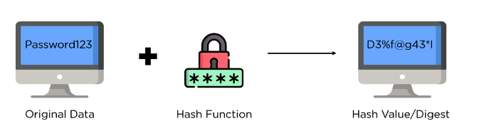
HASHING:
A hash value, or hash function, is a fixed-length string of numbers and letters generated from a mathematical algorithm and an arbitrarily sized file such as an email, document, picture, or other type of data.
This generated string is unique to the file being hashed and is a one-way function—a computed hash cannot be reversed to find other files that may generate the same hash value.

Slide 21
AES :
The AES Encryption algorithm (also known as the Rijndael algorithm) is a symmetric block cipher algorithm with a block/chunk size of 128 bits. It converts these individual blocks using keys of 128, 192, and 256 bits.
It encrypts the blocks and joins them together to form the cipher text.
It is based on a substitution-permutation network, also known as an SP network. It consists of a series of linked operations, including replacing inputs with specific outputs (substitutions) and others involving bit shuffling (permutations).
AES is used to transfer files between associates in an encrypted format
Based on the length of the key, the number of rounds will vary as follows:
1. For 128bit key there are 10 rounds
2. For 192bit key there are 12 rounds
3. For 256bit key there are 14 rounds

Slide 22
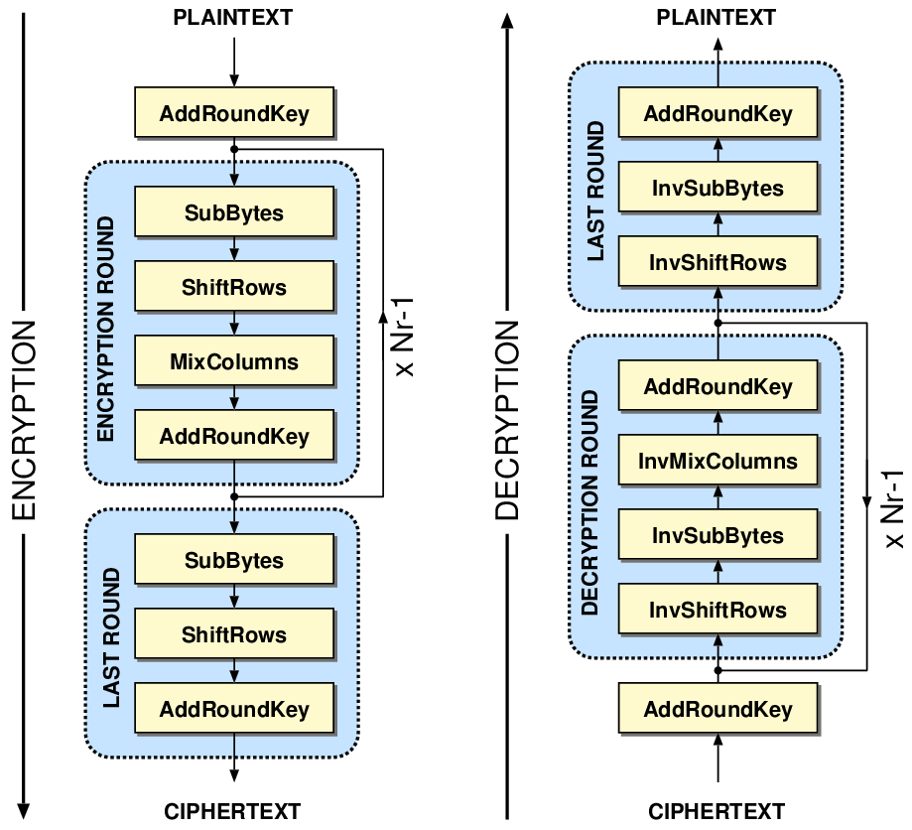

Slide 23
TECHNOLOGY STACK:
HARDWARE REQUIREMENTS
PROCESSOR : DUAL CORE 2 DUOS
RAM :2 GB DD RAM
HARD DISK :250 GB
SOFTWARE REQUIREMENTS
FRONT END : J2EE (JSP, SERVLET)
BACK END : MY SQL 5.5, AWS CLOUD
OPERATING SYSTEM : WINDOWS 7
IDE : ECLIPSE

Slide 24
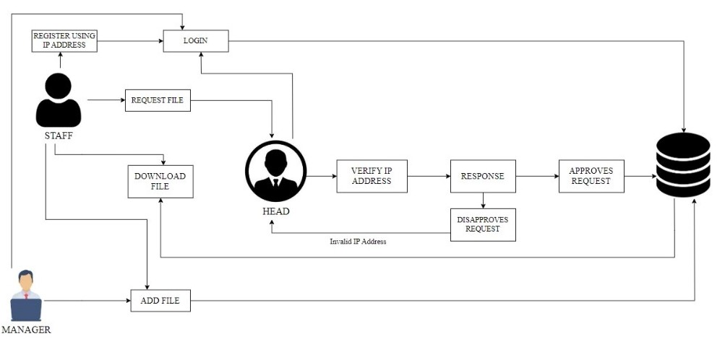
SYSTEM ARCHITECTURE:

Slide 25
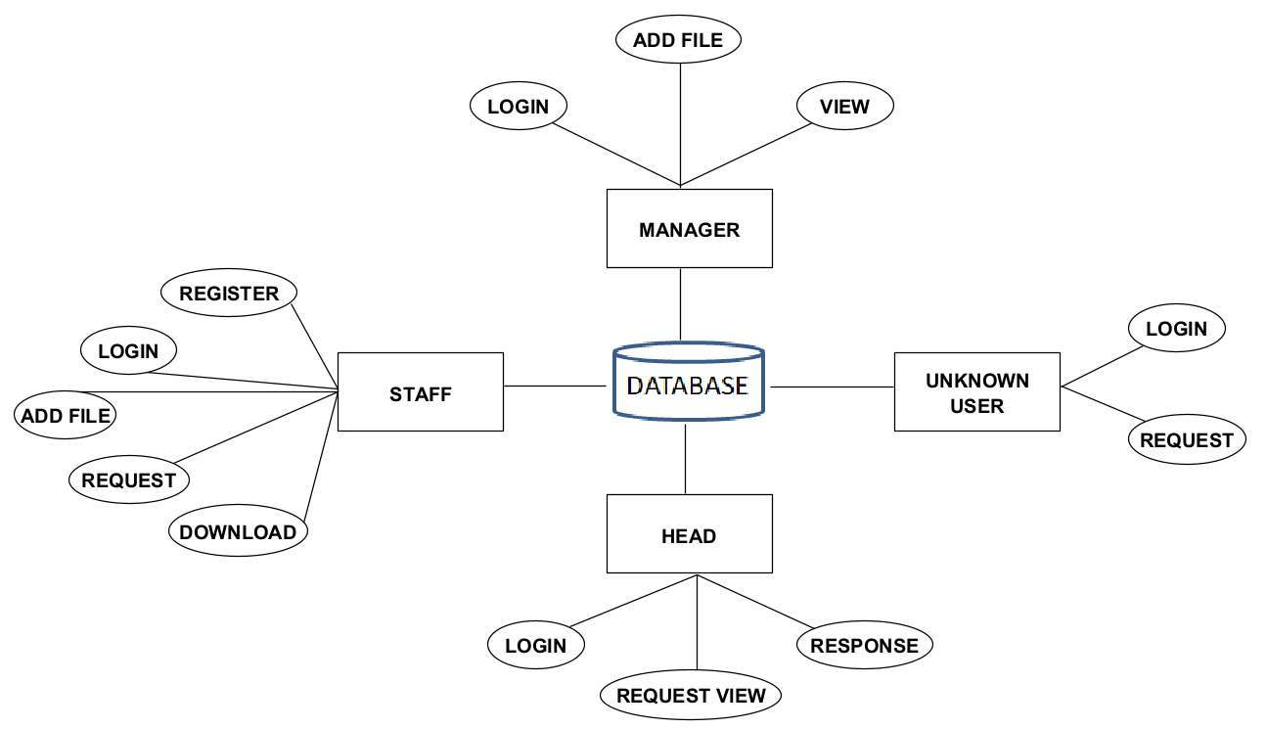
ER DIAGRAM:

Slide 26
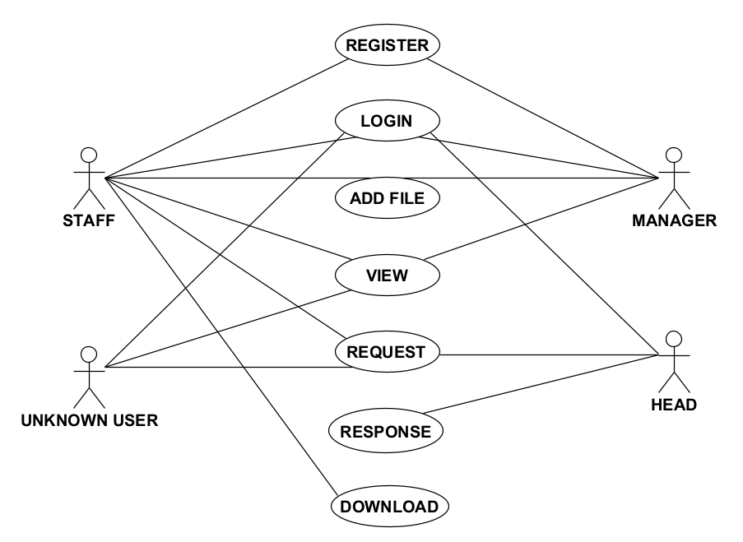
USECASE DIAGRAM:

Slide 27
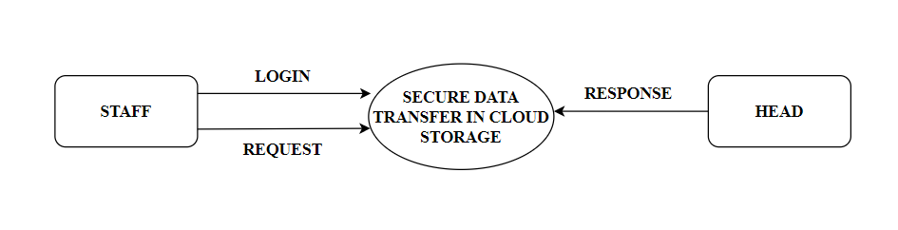
DATAFLOW DIAGRAM:
LEVEL 0:

Slide 28
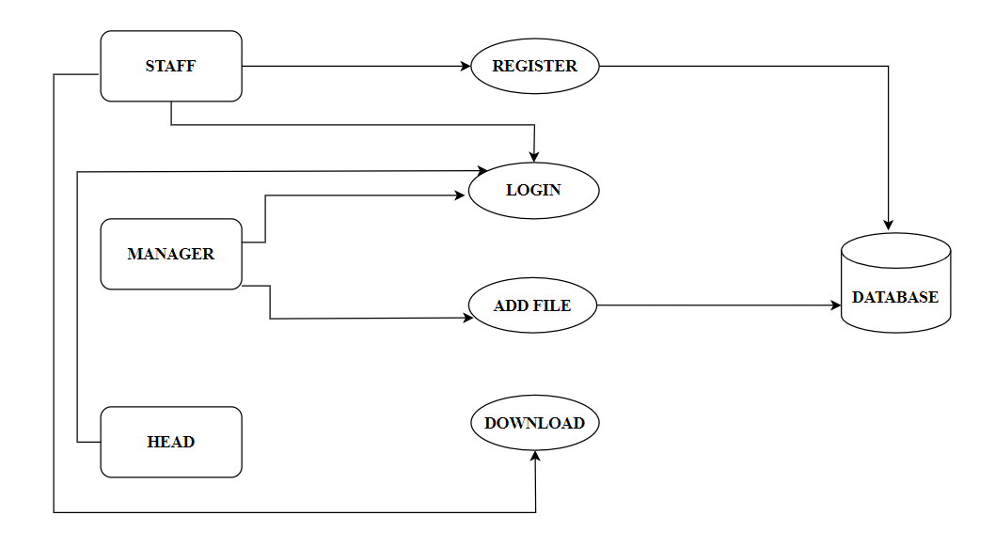
LEVEL 1:

Slide 29
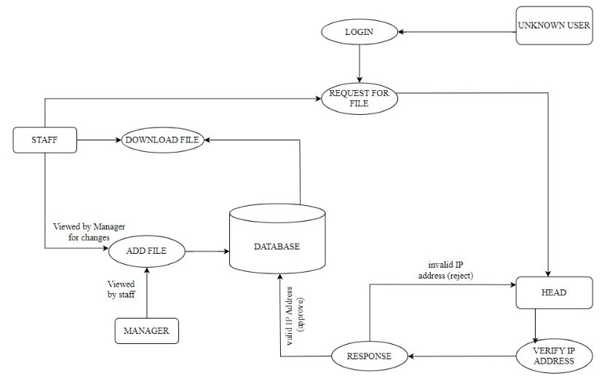
LEVEL 2:

Slide 30
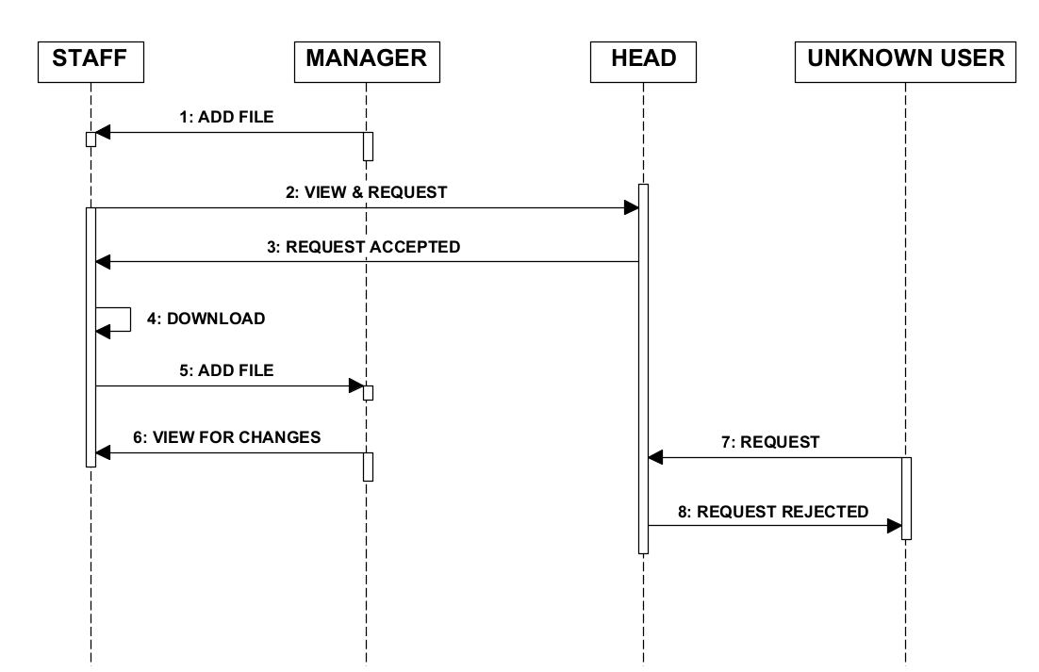
SEQUENCE DIAGRAM:

Slide 31
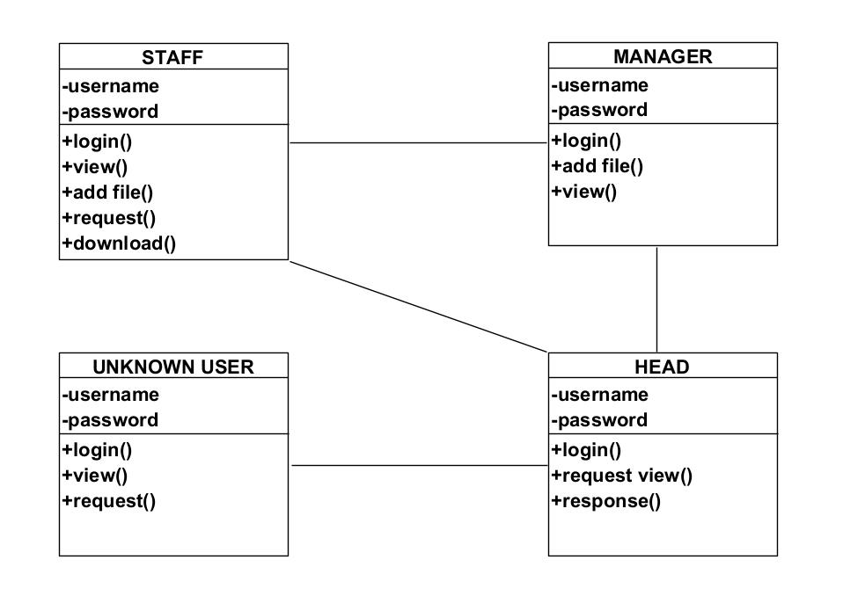
CLASS DIAGRAM:

Slide 32
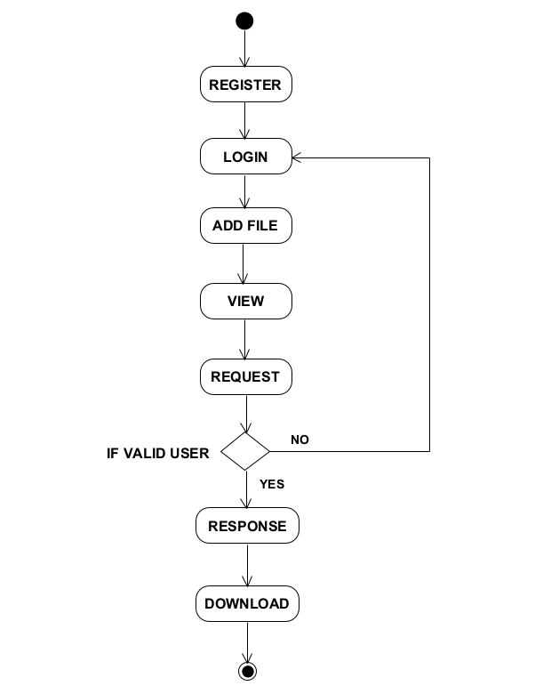
ACTIVITY DIAGRAM:

Slide 33
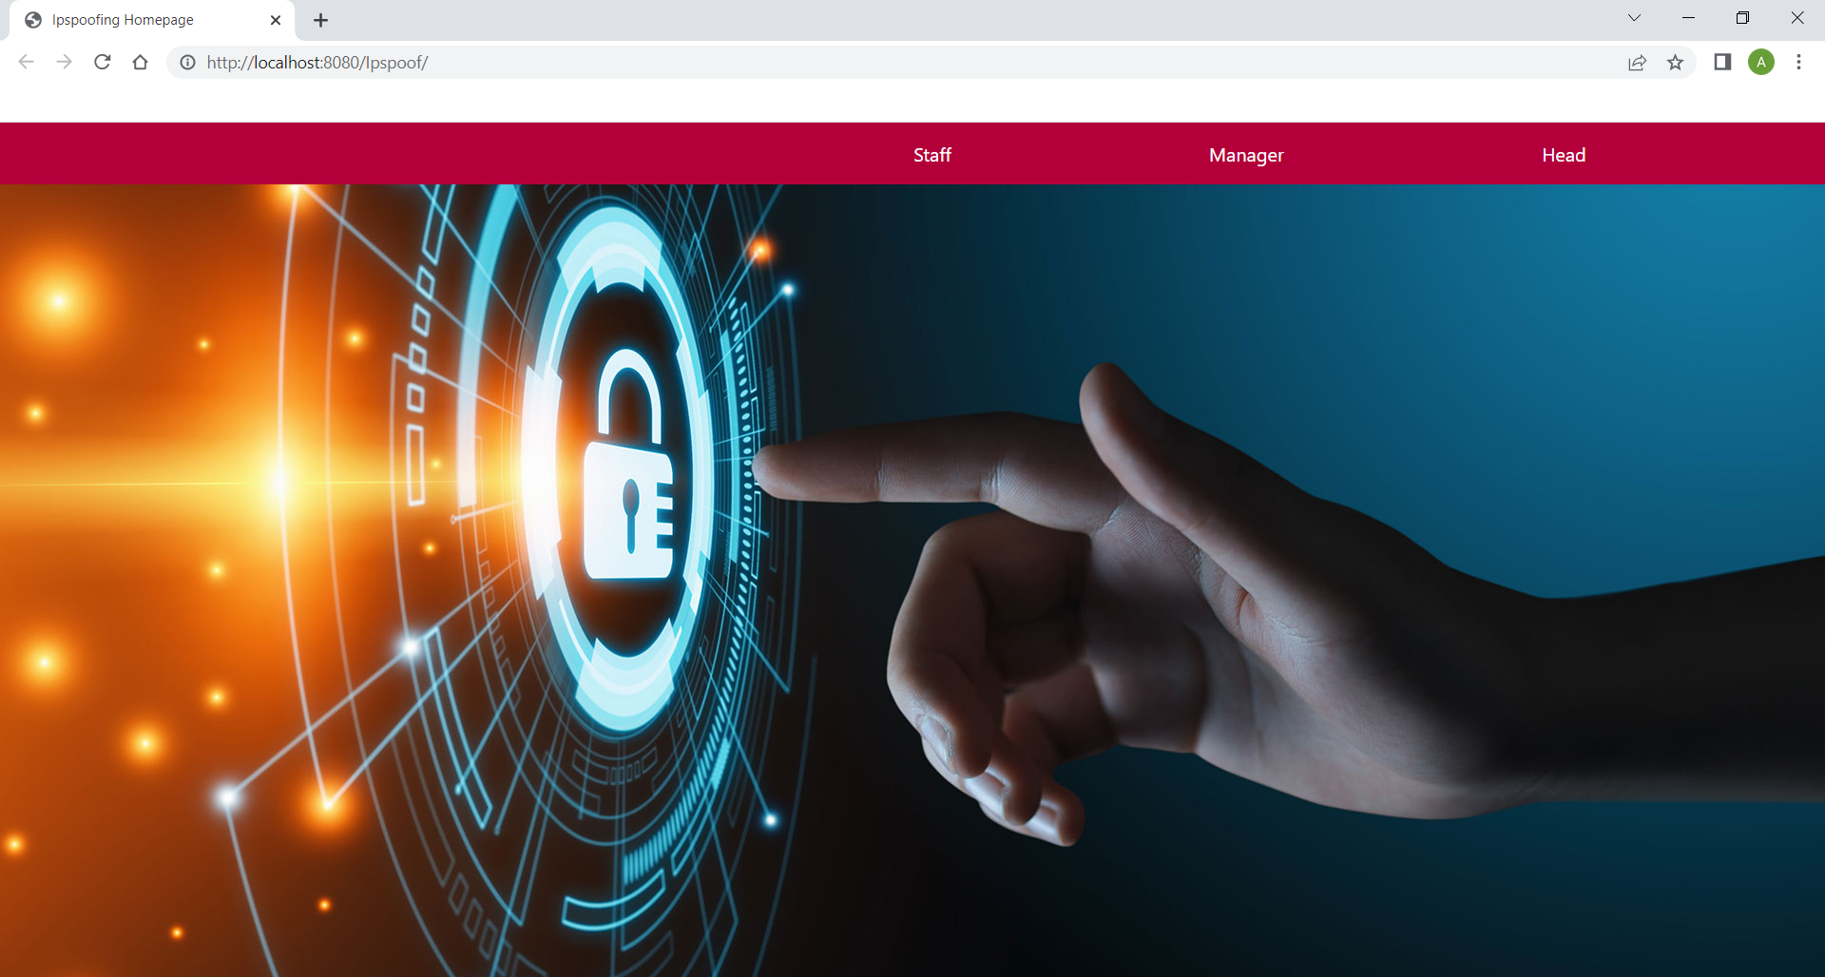
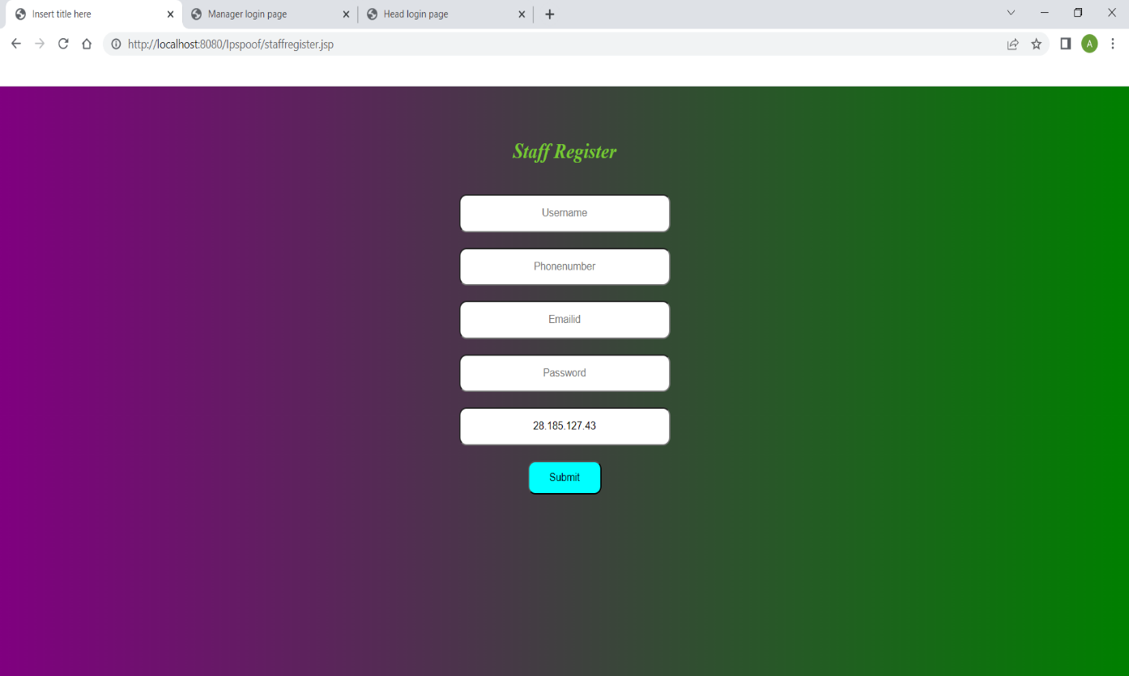
SCREENSHOTS:
HOMEPAGE
STAFF REGISTER

Slide 34
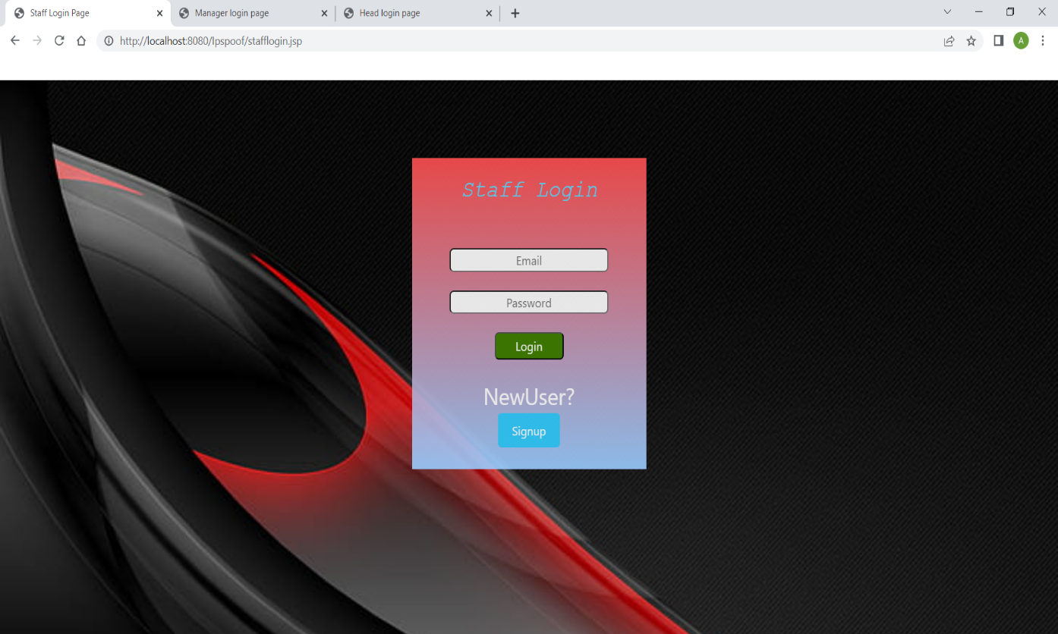
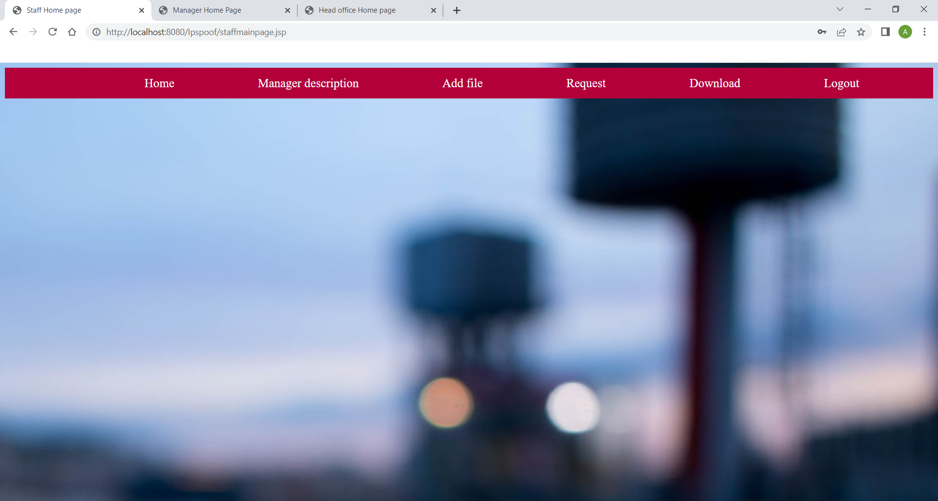
STAFF LOGIN
STAFF HOMEPAGE

Slide 35
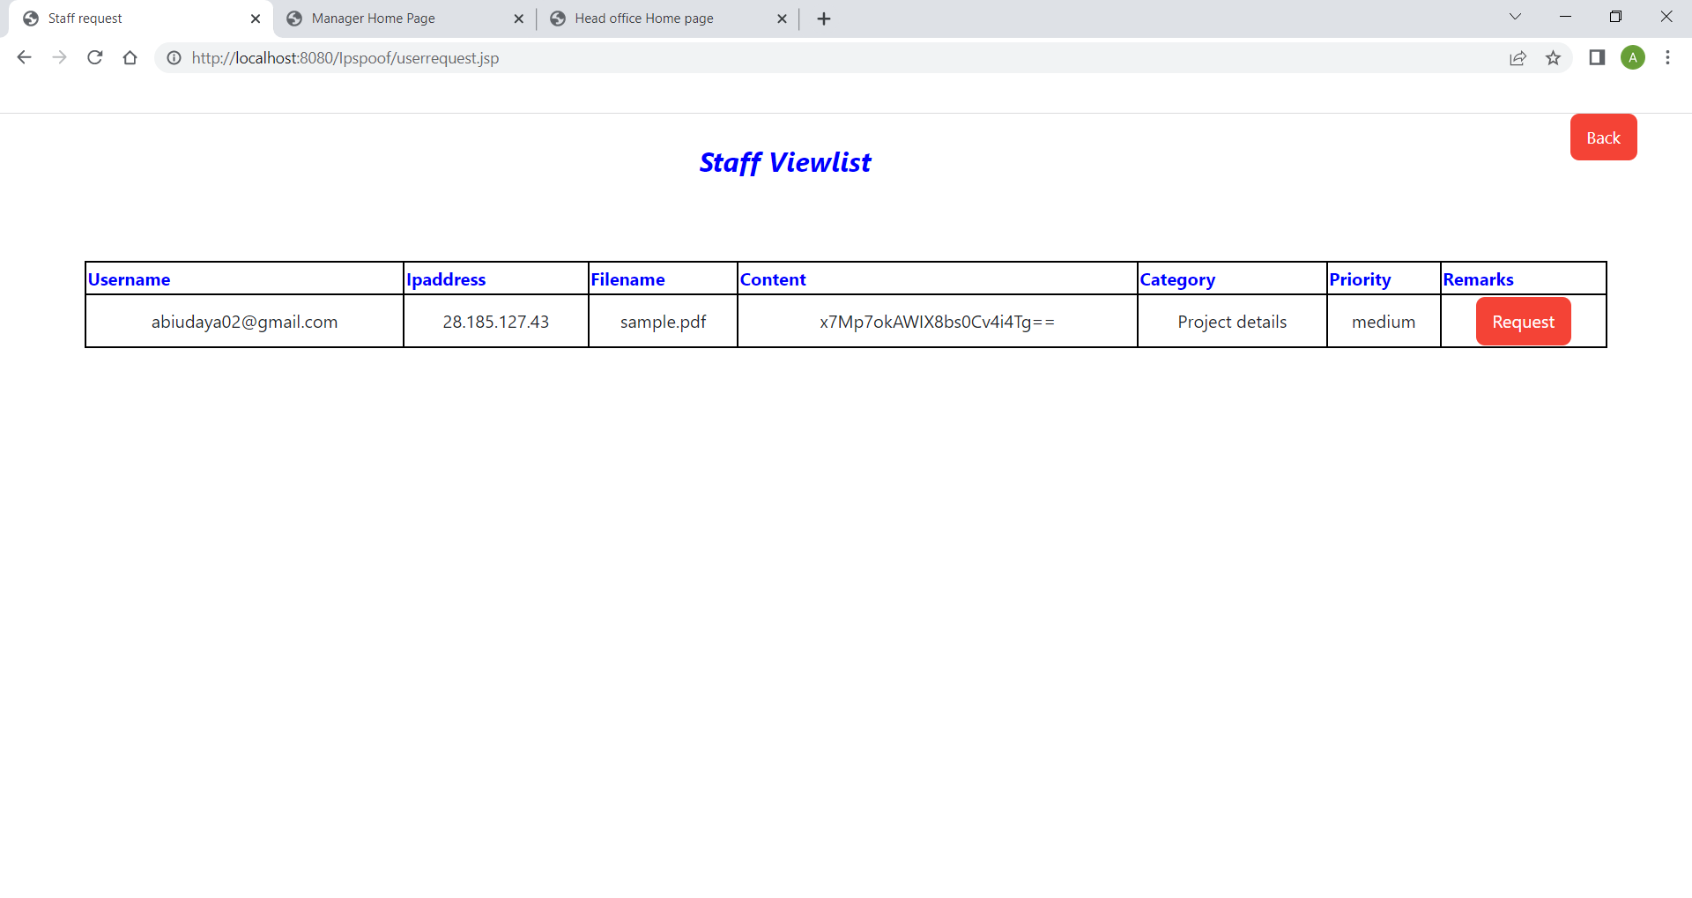
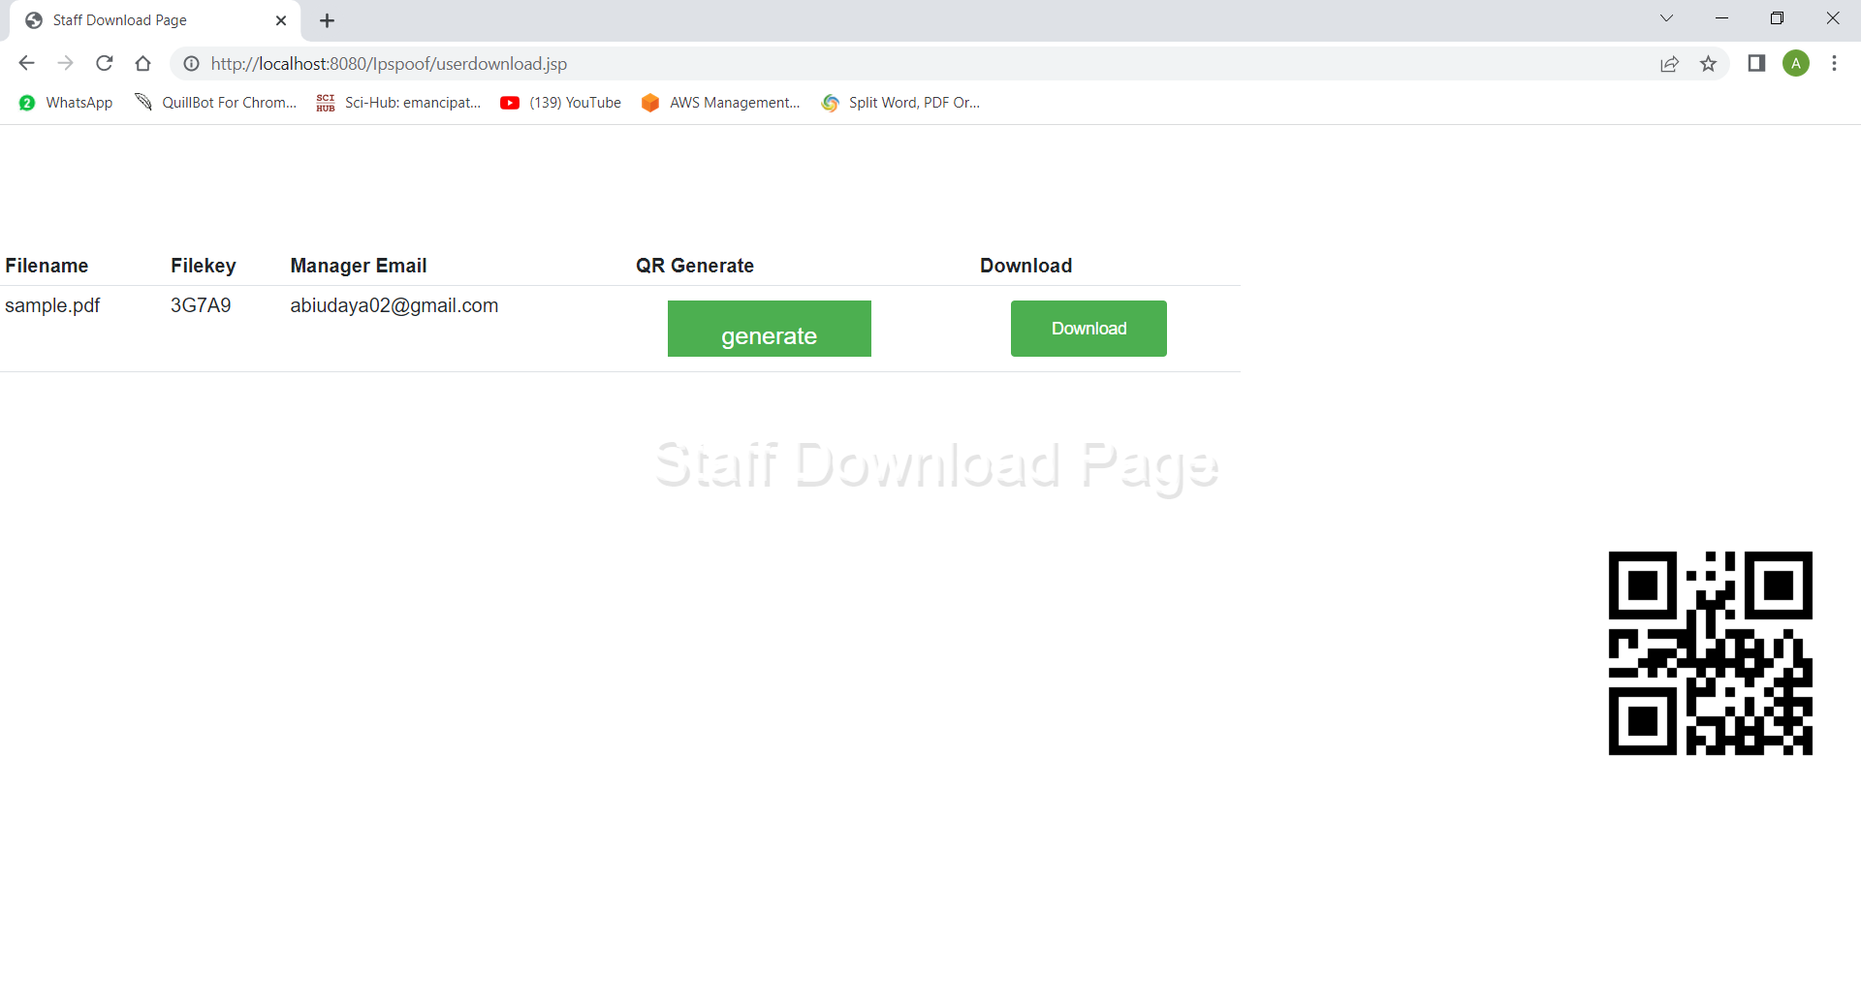
REQUEST
DOWNLOAD

Slide 36
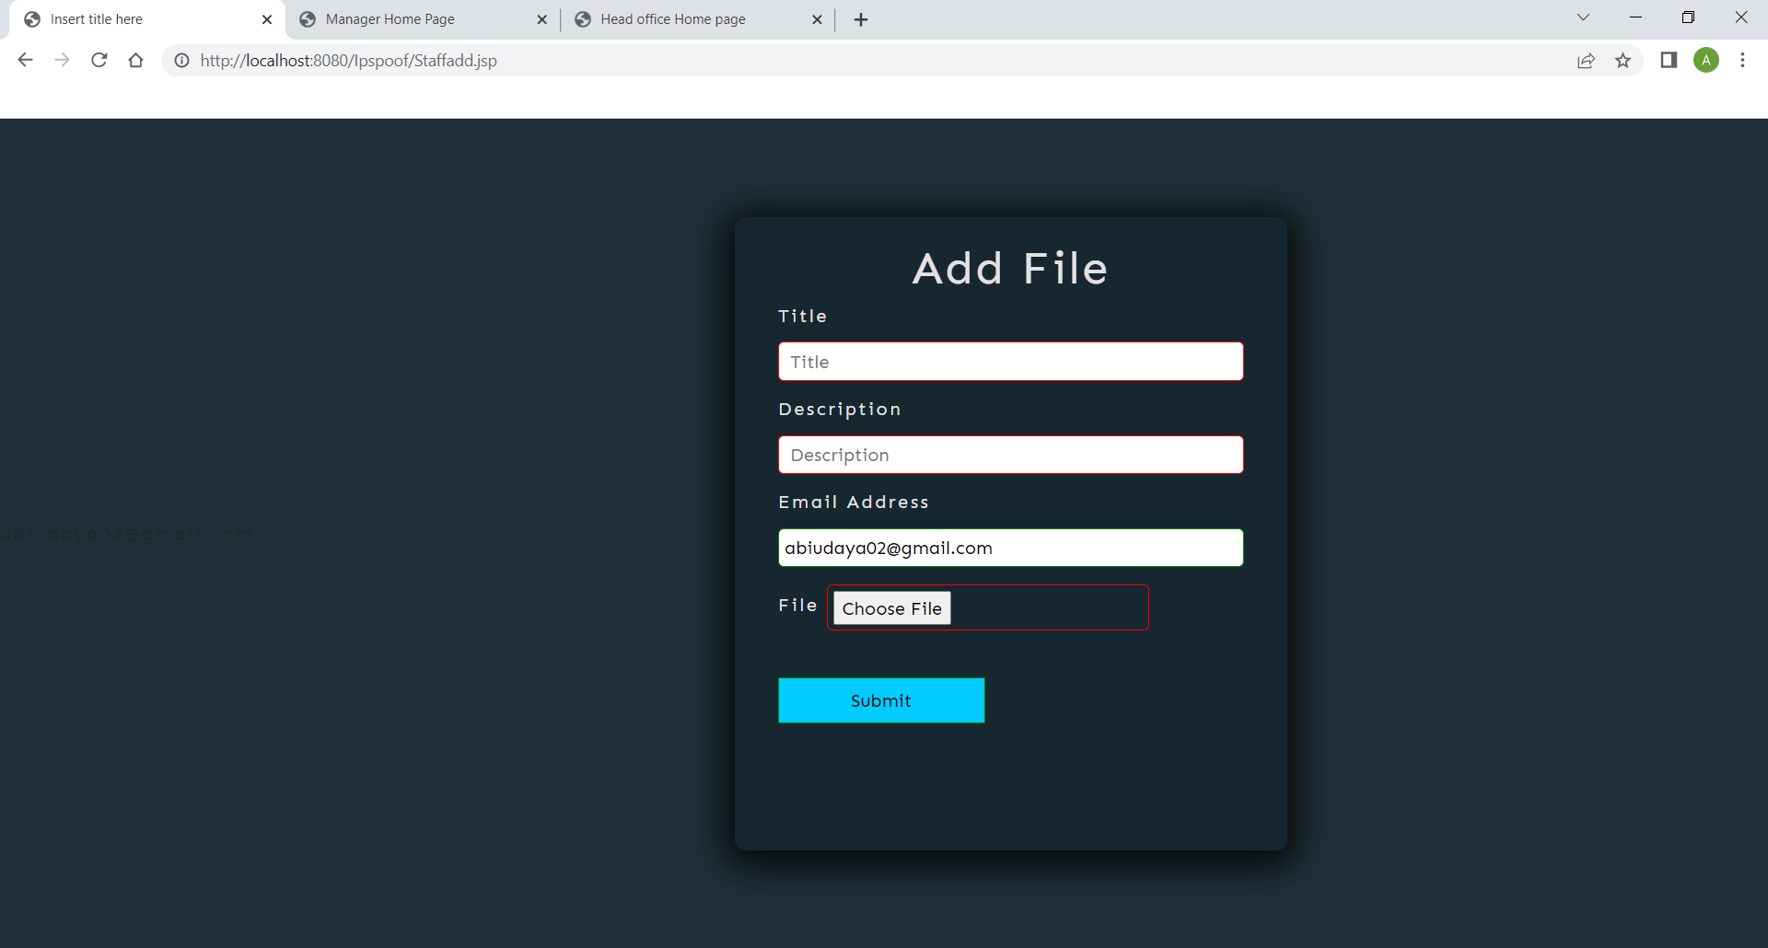
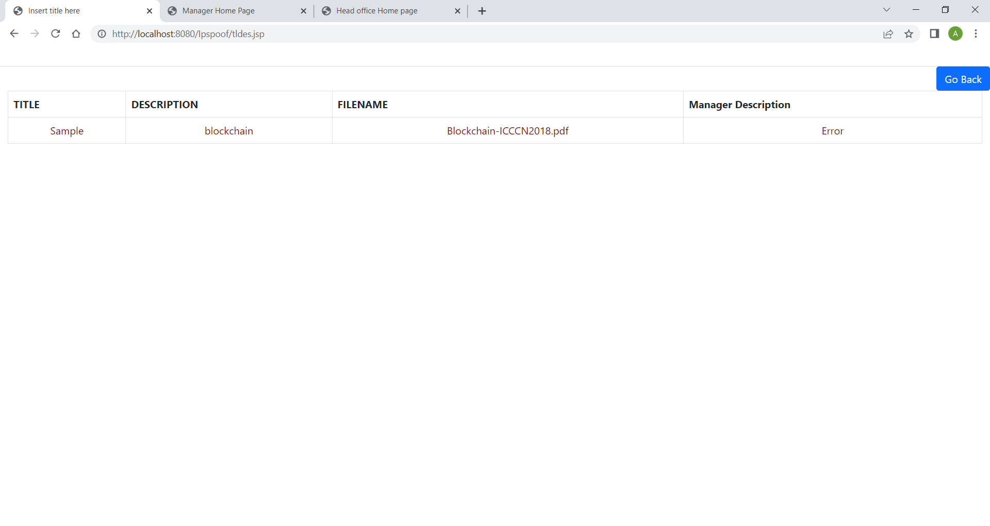
ADD FILE
MANAGER DESCRIPTION

Slide 37
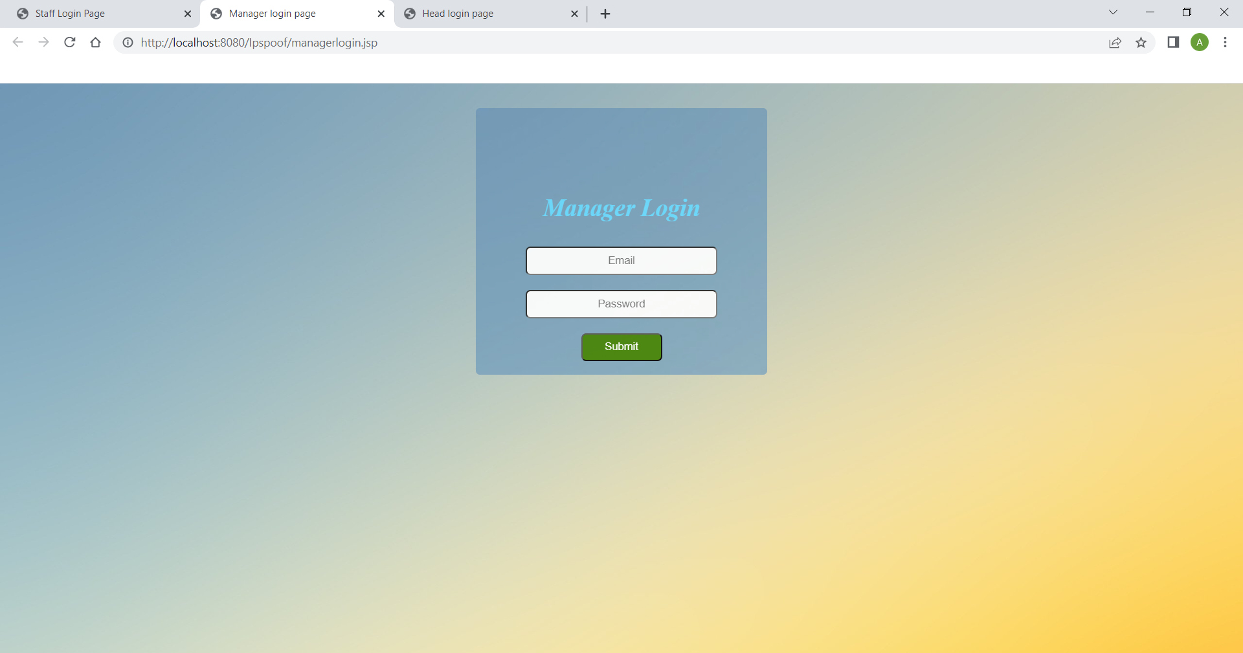

MANAGER LOGIN
MANAGER HOMEPAGE

Slide 38
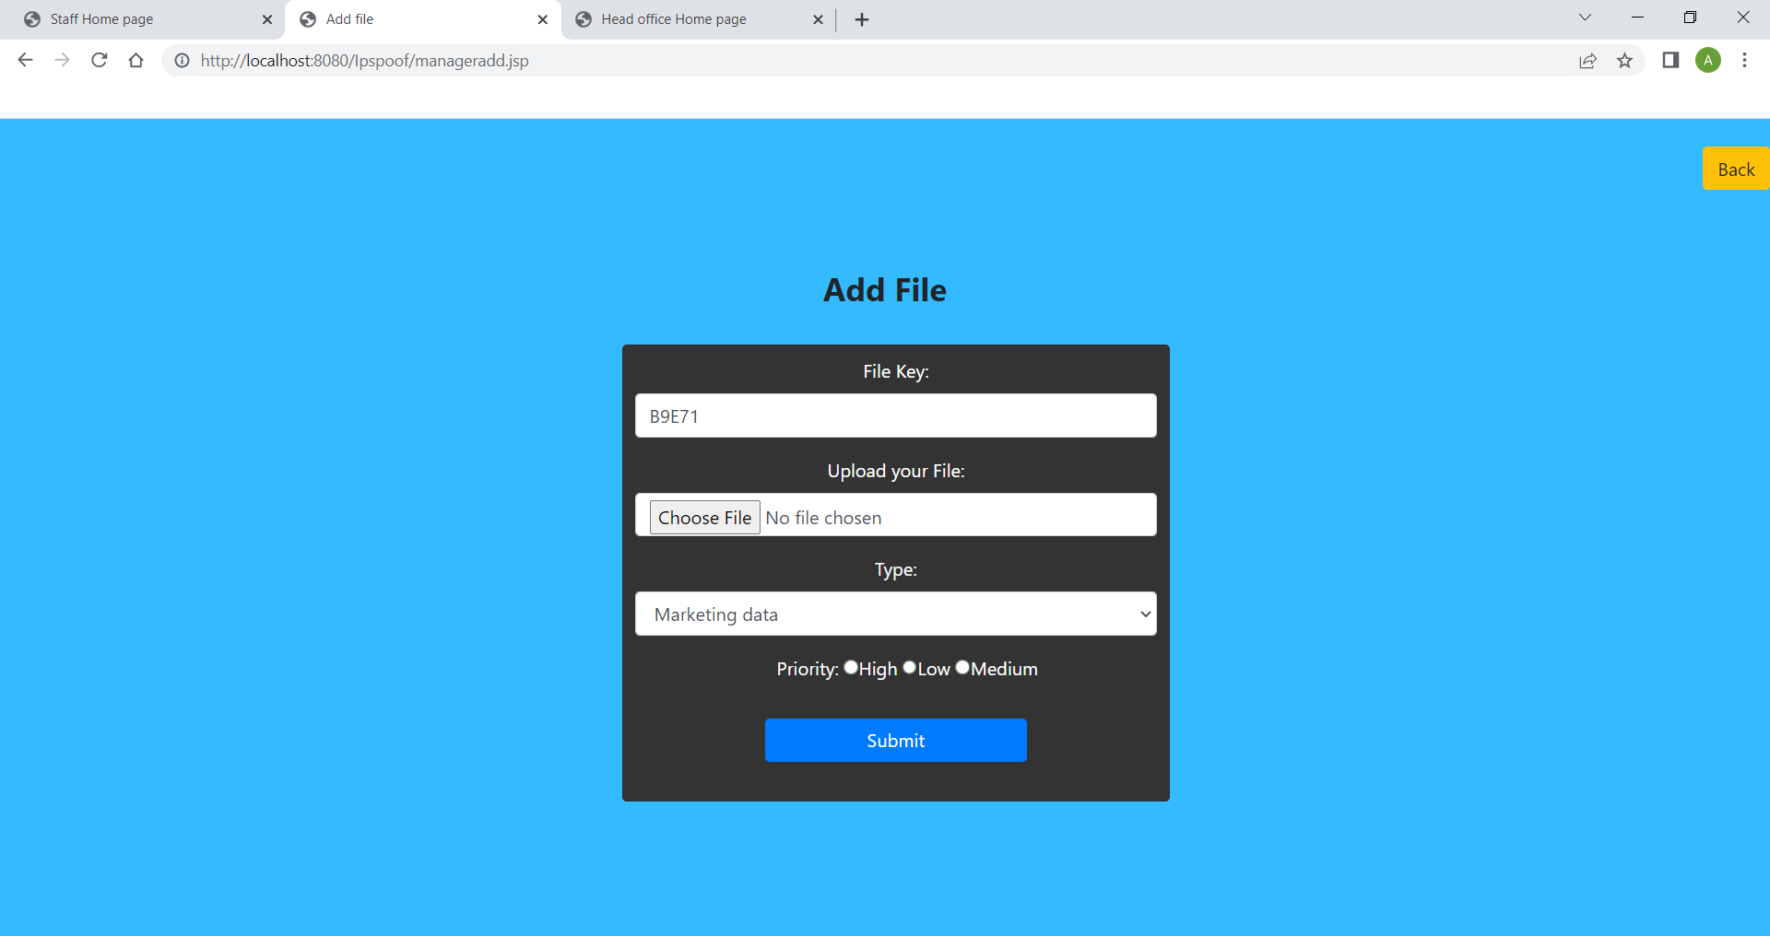
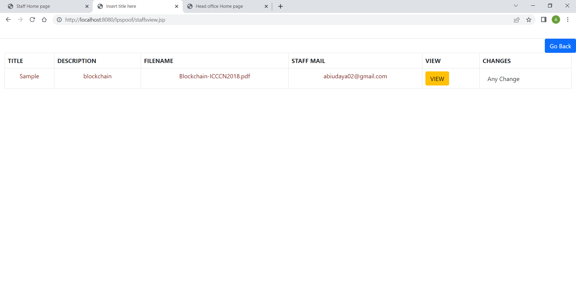
ADD FILE
STAFF DESCRIPTION

Slide 39
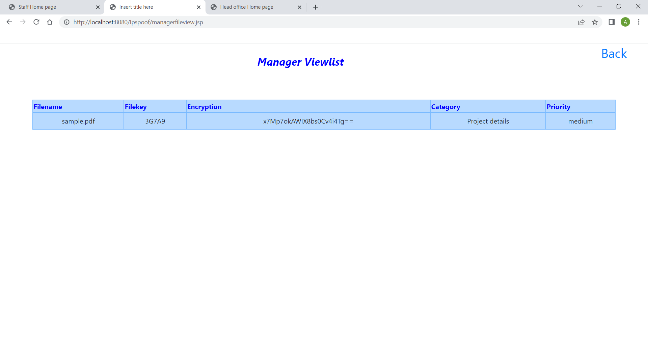
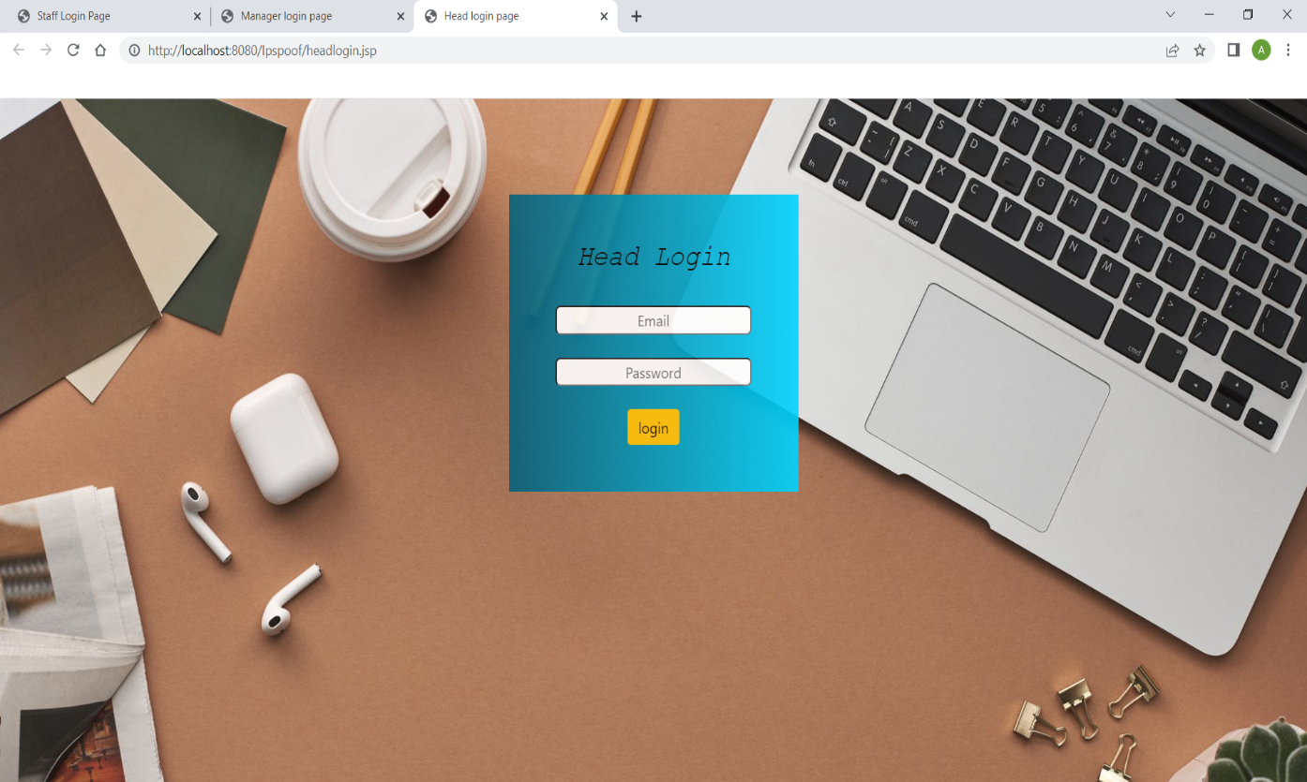
VIEW
HEAD LOGIN

Slide 40
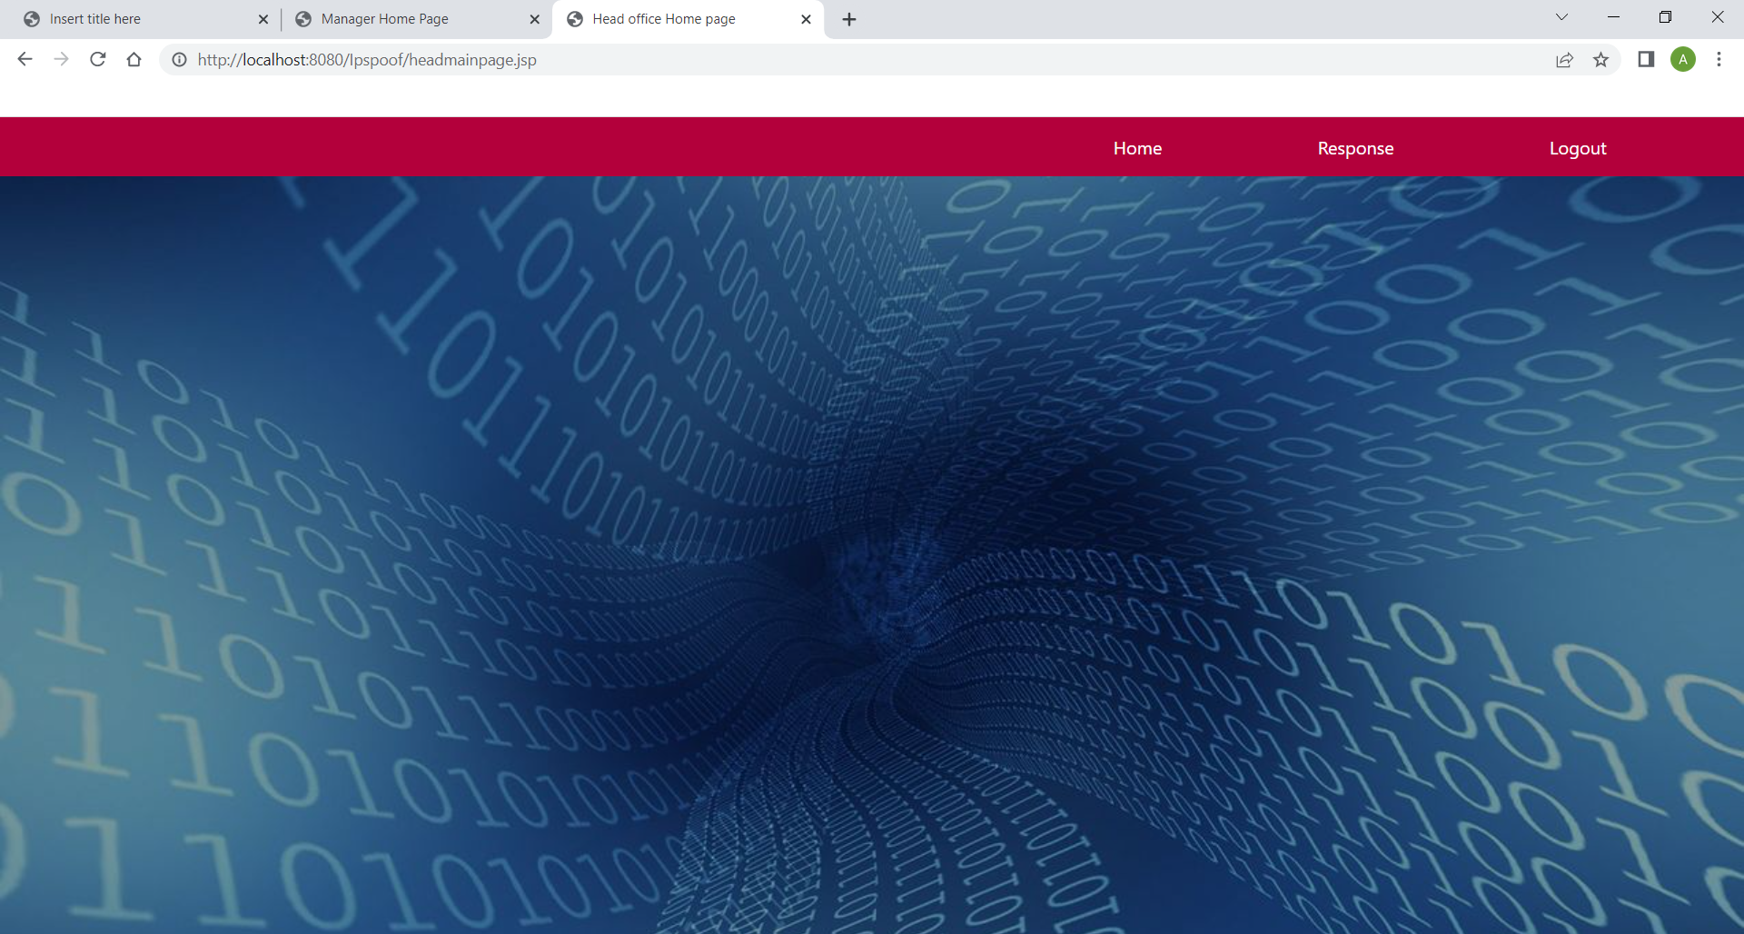
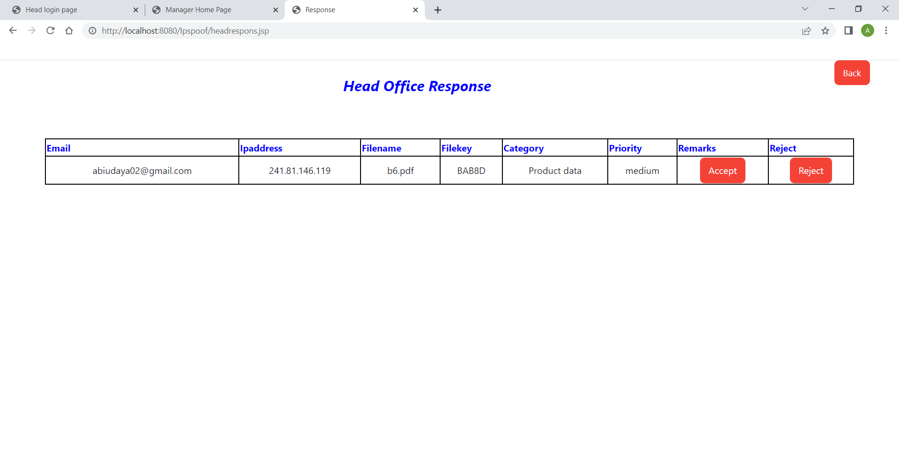
HEAD HOMEPAGE
RESPONSE

Slide 41
CONCLUSION:
Several sectors, including machine learning, banking, and the military, are utilizing blockchain, a new technology. Users share a significant amount of data daily. In this paper, we offered a more secure way to share files and store them on a reliable platform like blockchain. This technique can partially eliminate all the drawbacks of having a centralized network for sharing confidential files within an organization. Sensitive information needs to be shielded from unauthorized access. We looked into how blockchain addresses the challenging requirements of security, storage, sharing, and authentication when examining data. Cloud storage with blockchain technology seems to be a smart solution for business organization.

Slide 42
REFERENCES:
Adam Bowers, Cong Liao, Douglas Steiert , Dan Lin , Anna Squicciarini, and Ali Hurson, “Detecting Suspicious File Migration or Replication in the Cloud”, 2021
Anusree K, Jagan Sathiaseelan Vadekkat, Abhinu R Dev, Abhinav, “Decentralized File Transfer System Blockchain-based File Transfer”, 2022
Devesh Solanki , Dev Mehta , Kaushal Modani, Sashank R M Dr Rashmi S, “An Android File Sharing System Using BlockChain & IPFS”, 2021
Jin Sun, Xiaomin Yao , Shangping Wang , and Ying Wu, “Blockchain-Based Secure Storage and Access Scheme For Electronic Medical Records in IPFS”, 2020
Anjaly Renny , Anjana Santhosh , Neeraja S, Teena Noyal, “File Storing and Sharing using Blockchain”, 2020

Slide 43
Shujie Cui, Muhammad Rizwan Asghar, Giovanni Russello, ” Towards Blockchain - based Scalable and Trustworthy File Sharing”, 2018
Xiaochen Zheng, Raghava Rao Mukkamala, Ravi Vatrapu, Joaqun Ordieres-Mere, “Blockchain-based Personal Health Data Sharing System Using Cloud Storage ”, 2018
Mathis Steichen, Beltran Fiz, Robert Norvill, Wazen Shbair and Radu, “Blockchain-Based, Decentralized Access Control for IPFS ”, 2018
Hoang Giang Do, Wee Keong Ng, “Blockchain-based System for Secure Data Storage with Private Keyword Search”, 2017
Marlene Goncalves, Graciela Perera and Stephen Rodabaugh, “Detecting illegal file sharing in Peer-to-Peer networks using fuzzy queries”, 2010

